Slide 1
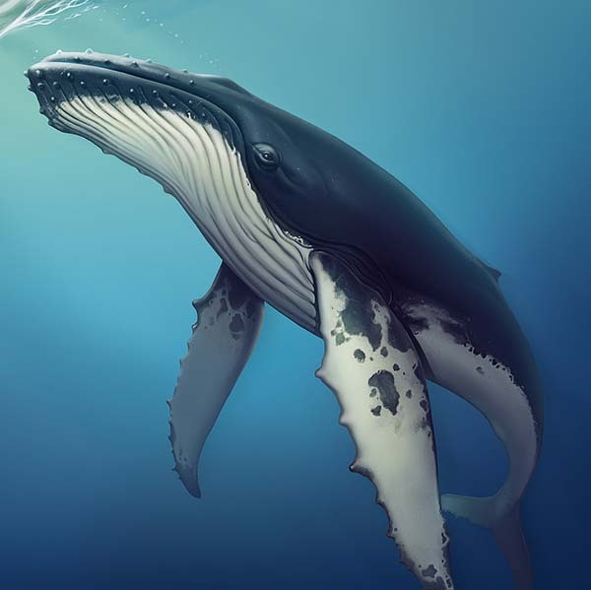
March 26
ALYC 2022 Whale Regatta
All PHRF RACERS
THE WHALE REGATTA Sponsored by The American Legion Yacht Club The “Whale Regatta” is dedicated to the annual migration of whales The race will start and finish in the vicinity of the Newport Pier
To Register and NOR: https://alyc.com/event-4534662

